Slide 1
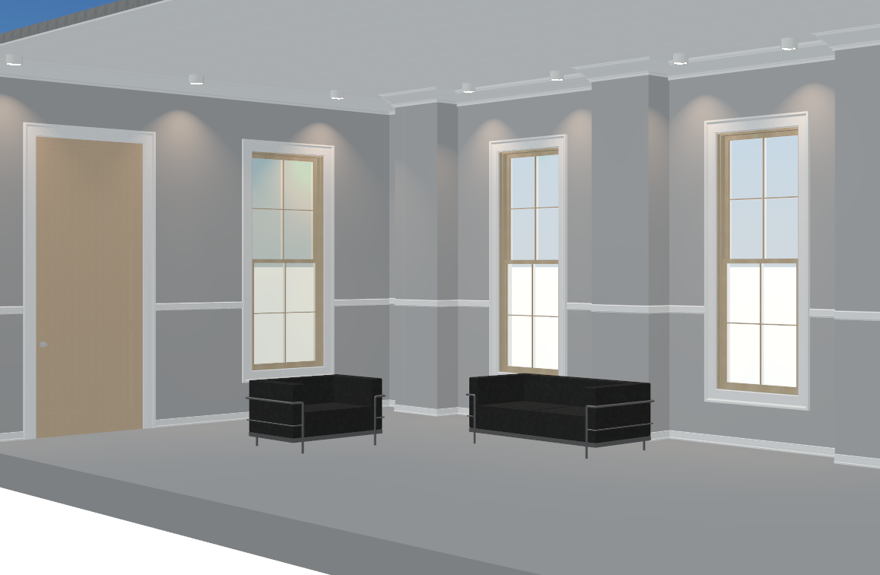
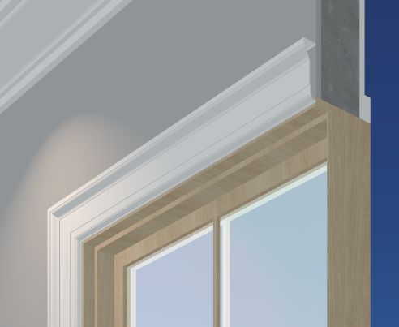
This guide provides information on applying Dahlstrom metal mouldings to common architectural elements allowing designers to evaluate trim options in the BIM model. It (this guide) specifically uses the Revit modeling environment.
Note: Application of metal mouldings to architectural elements differs from general casework specification. Please consult the factory on you specific application.
The .zip file contains Revit elements of profiles, a door family sampler, a window family sampler and a mockup room project file. Click Here for the File

Slide 2
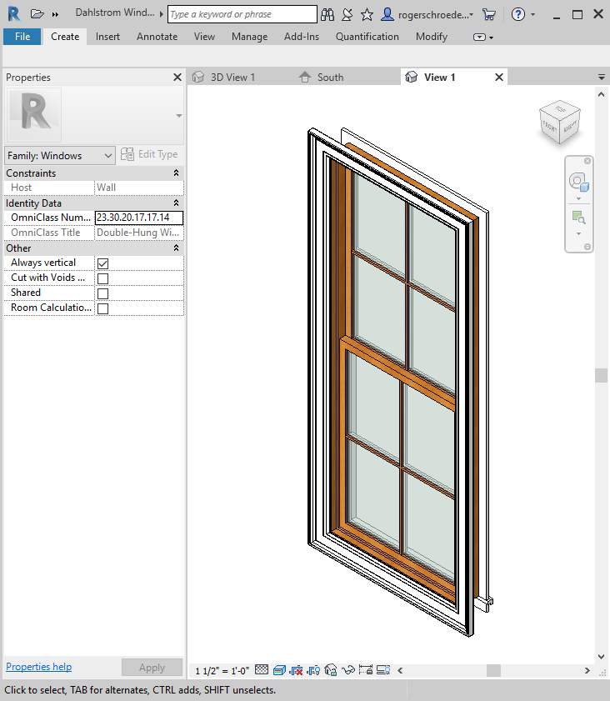
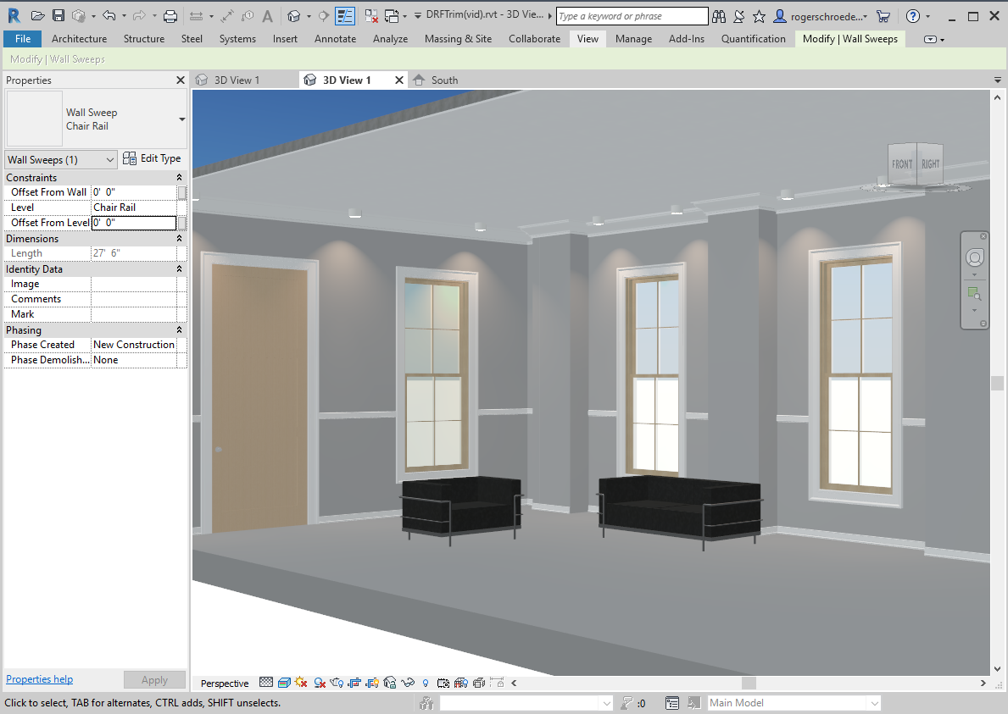
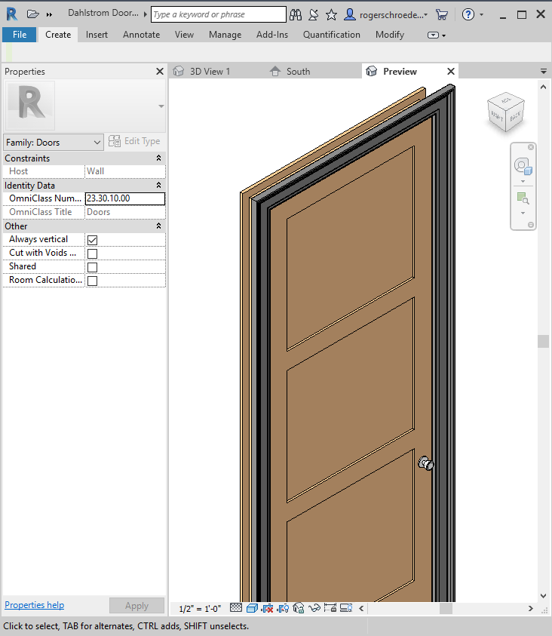
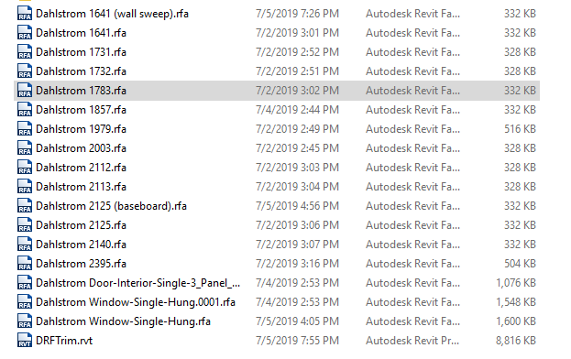
The .zip file contains Revit elements of profiles, a door family sampler, a window family sampler and a mockup room project file. Click Here for the File

Slide 3
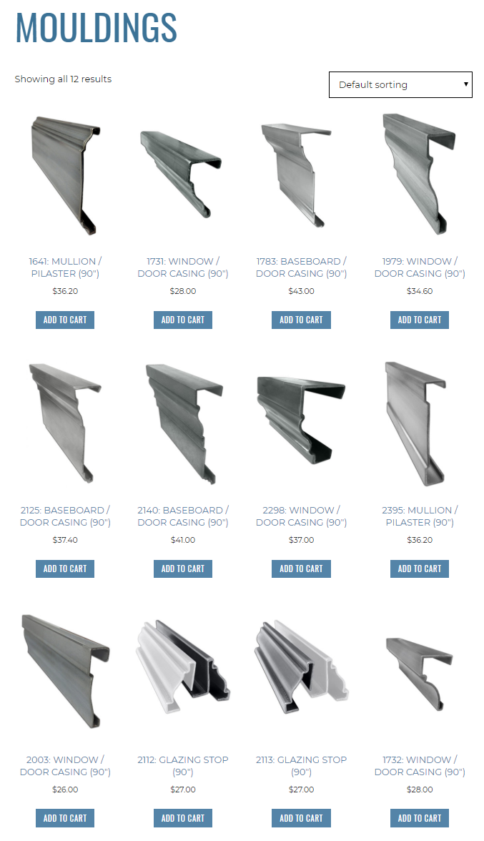
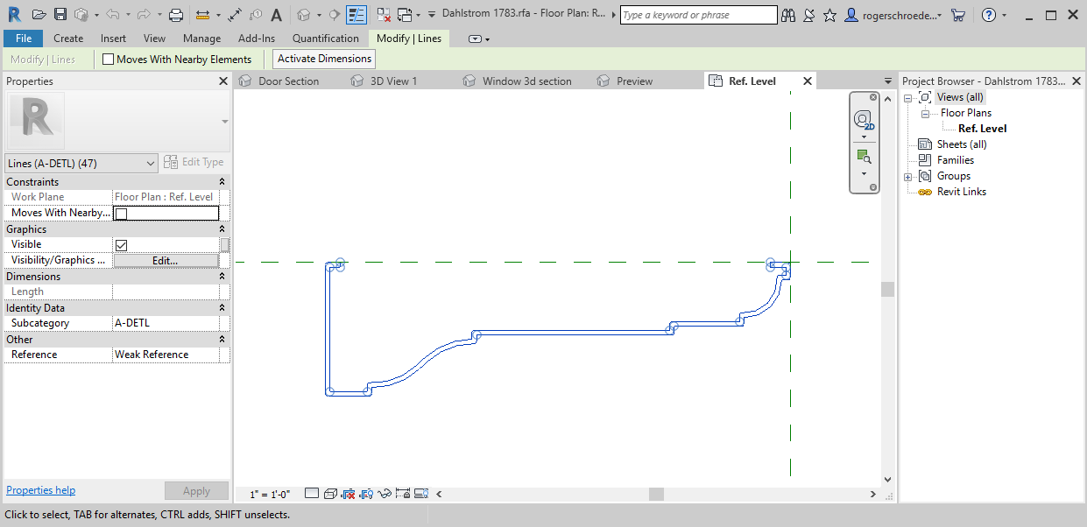
The mouldings provided are currently from our online store selection. CAD data has been used to create Revit family profiles that can be applied to doors, windows and walls.
The .zip file contains Revit elements of profiles, a door family sampler, a window family sampler and a mockup room project file. Click Here for the File

Slide 4
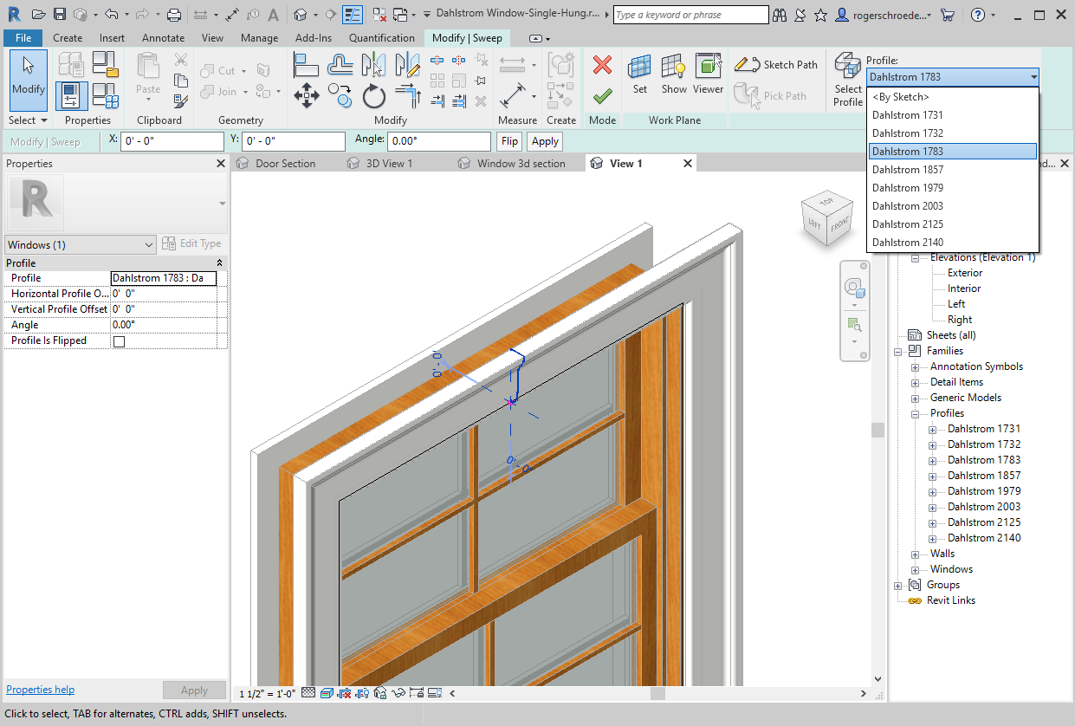
Using the Window Sampler File
The window sampler family file contains a window with interchangeable sweep profiles of selected Dahlstrom metal moulding profiles.

Slide 5
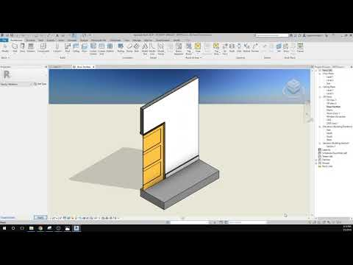
Using the Window Sampler Family
Video overview on selecting a Dahlstrom moulding profile in a single hung window.

Slide 6
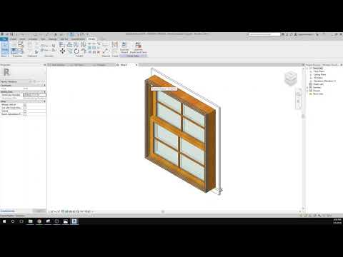
Adding a Dahlstrom Profile to a New Window Family
Video overview on applying a Dahlstrom moulding profile in a new window family.

Slide 7
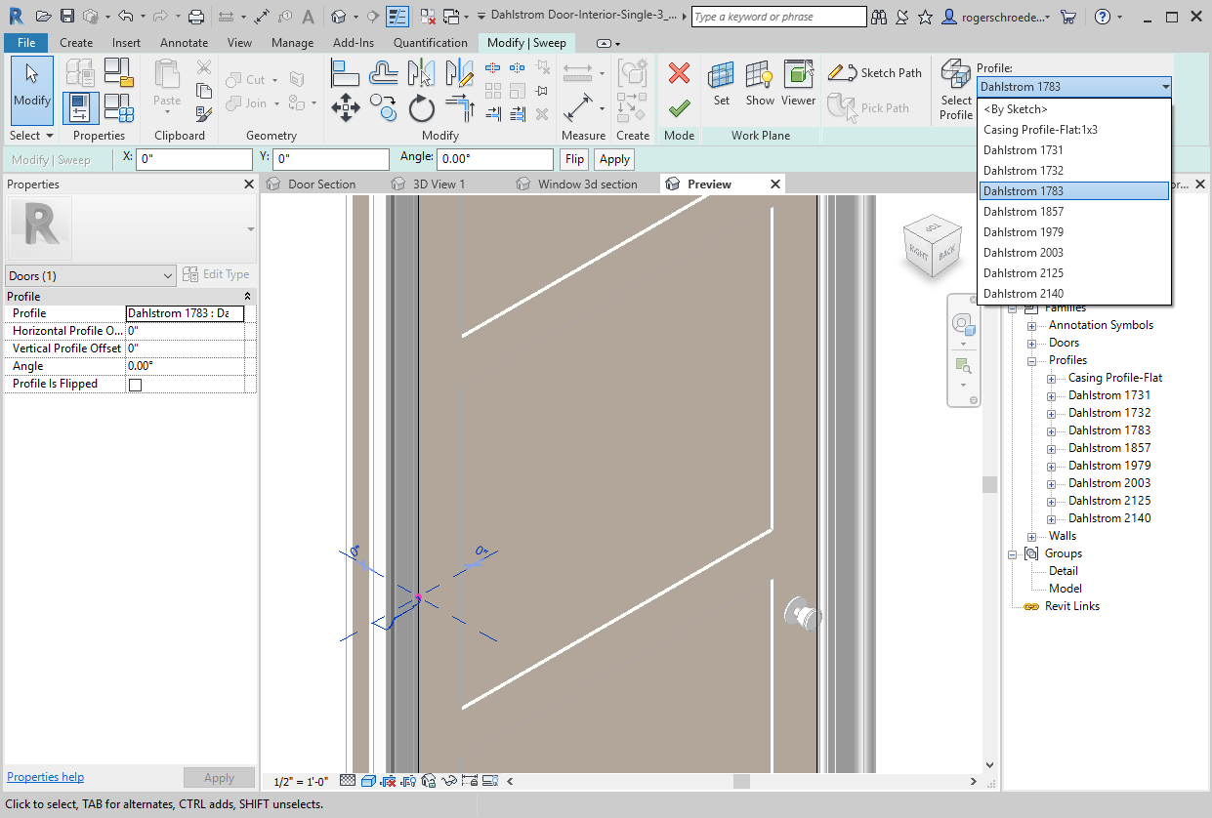
Using the Door Sampler File
The door sampler family file contains a door with interchangeable sweep profiles of selected Dahlstrom metal moulding profiles.

Slide 8
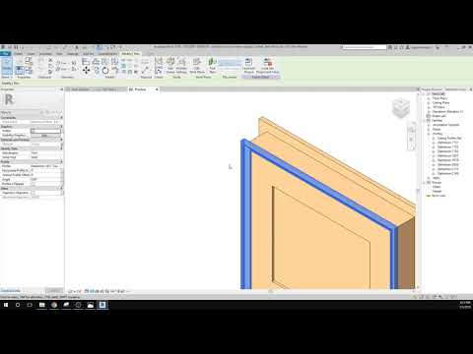
Using the Door Sampler Family
Video overview on selecting a Dahlstrom moulding profile in a 3 panel door.

Slide 9
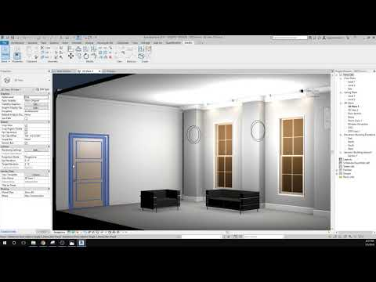
Adding a Dahlstrom Profile to a New Door Family
Video overview on applying a Dahlstrom moulding profile in a new door family.

Slide 10
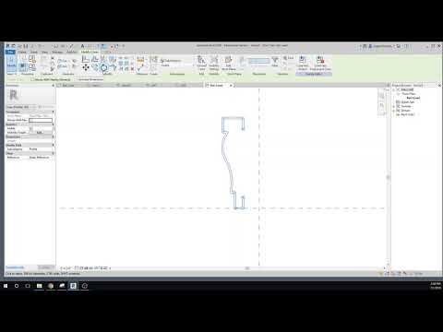
Creating a Profile
Video overview on selecting a Dahlstrom moulding profile as a .dwg file and creating a family profile from it.

Slide 11
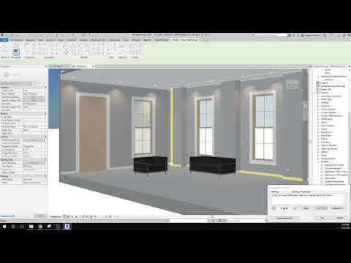
Applying Moulding Sweeps to Walls
Video overview on importing Dahlstrom moulding profiles for use in wall sweeps.

